Slide 1


Software Testing & Quality (11)
Testing for Security

Slide 2
Highlight
Why someone would want to break into a computer
What types of break-ins are common
How to work with your design team to identify security issues
Why software security problems are nothing more than software bugs
How can find security vulnerabilities
How the new filed of computer forensics is related to software security testing

Slide 3

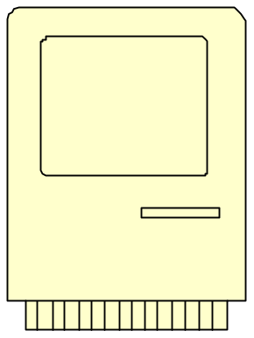
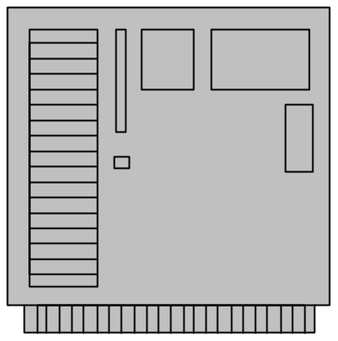

A example - WarGame, 1983
US Government NORAD
IMSAI 8080

Slide 4
Understand the motivation
Challenge or prestige
Curiosity
Use/Leverage
Vandalize: 3-D (defacing, destruction, denial of service - DoS )
Steal

Slide 5
Threat modeling
Assemble the threat modeling team
Identify the assets
Create an architecture overview
Decompose the application
Identify, rank and document the threats
Rank: damage potential, reproducibility, exploitability, affected users, discoverability

Slide 6
5 Principles Needing to Test
Authentication: Identity - Validity
  Login, timeout, failures, pw changes, mins/maxs, stored encrypted, bypass captured URL, handling deletion of outdated, expirations, 2-factor: atm
  Unix: Access.conf, .htaccess, .nsconfig
  Windows: challenge/response; SSO; Passport
Integrity: protection from tampering/spoofing
Privacy: protection from eavesdropping
Non-Repudiation: accountability
Availability: RAID,clusters,cold standbys
Notes:
5 Principles of Security Test: A process!
Integrity: dig sigs
Availability: Prevent denial of service by disabling unneeded services, hiding internals, filtering (allow/deny) traffic, and load balancing

Slide 7
Some concepts
Certificates
LDAP
Cryptography
  Symmetric: Kerberos, Blowfish, DES
  Asymmetric: RSA, MD5, SHA-1
Encryption
Notes:
Dig sigs are a bit length hash constant (cipher) combined with a private key (variable). It should be tested that they are not modified or altered.
Symmetric Keys use a reverse process using the SAME key. DES (by IBM) in the 70’s was considered high standard using a 56 bit key 2 to the 56 power (or 72 quadrillion keys).
Blowfish was developed by Bruce Sheier, author of excellent security book, “Secrets and Lies”.

Slide 8
SERVERS: web, app, database server
OS’s: NT, UNIX, LINUX
Somarsoft’s DumpSec Reports
Configuration: shares, services, registry, user enumeration, Access/Object Privileges/Views/Stored Procs
Preventing DoS
Preventing Buffer Overflows (example in P.202)
Log Files: keep separate - less traffic
Patches
Compilers/Interpreters - don’t keep in cgi-bin
Notes:
Denial of Service attacks a server with bad data- Check the length of all buffers and inputs before storing them. Do load testing/load balancing. Not of sheer volume, but verifying the number of packets sent.
Ex) PCANY 9/10 – random characters inserted may cause many open connections/SYN attack creates too many zombie processes
Buffer Overflows: Not as possible in .Net framework since ‘verified code’ checks the assembly BEFORE executing.
Use a boundary router to isolate the network- don’t wait until null.
Ex) UPnP (universal plug and play in XP) will echo endless download of discovery or “Notify Directives” of devices on system. It will flood so hacker can run their own code. Disable SSDP Discovery Service (NOT UPnP Device Host).

Slide 9
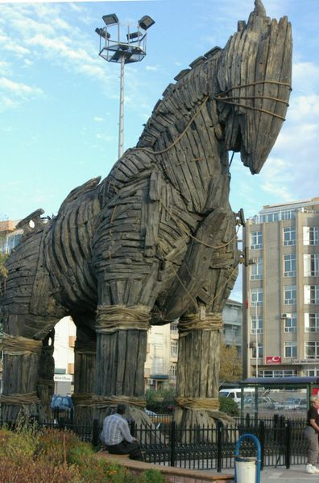
CLIENT: browser, other apps, components
Browser settings: Zones
Macros - Shift
OLE
Trojan Horses
Floppy Boot in BIOS
Notes:
Cookies never accepted in Restricted Zone

Slide 10

Cookies
AcceptingCookies: Cannot be used as a virus or plug-in
  http://www.cookiecentral.com/
    text only
    Max 4k
    Windows: Cookies.txt
    Unix: can be read into PERL using $ENV{‘HTTP_COOKIE’}
    When deleting - close browser first!
    NS limit = 300 total/20 per domain
    IE limit = 2% default
Notes:
Encrypted in .Net
“Super Cookies” – intruder uses jscript to grab GUID in Windows Media Player (GUID)- grab your web sites from temporary internet folder.

Slide 11
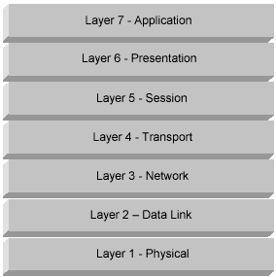
Open Systems Interconnect
Notes:
The Firewall Architecture Communication Stack.
Layer 1- Hardware/Media
2- Ethernet/LAN – Mac addresses
3- WAN – IP
4- TCP Ports
5- SSL
These network layers are just 1 example of how we can build test cases to break out the security testing by architectural layer. The tip of the iceberg! Add on services include DHCP and VPN.

Slide 12
Protocols
SSL, TLS, PCT - session layer 2 sided (both c and s must be configured)
S-HTTP - application layer
IPSec - network or IP layer (implemented in routers/switches)
Notes:
Microsoft owns PCT (Private Communications Technology)
SSL on 443 needs client AND server authentication on the IP Stack

Slide 13
NETWORK
Firewalls - catch all rule: everything not previously allowed is explicitly denied
Router based (Packet filtering) at IP level
  Headers inspected based on port, protocols, and destination/source IP addresses
Proxy based (gateways)
  More secure: software on the perimeter
  Proxy server interacts with internet and extensively logs traffic
  Can be used in combo if a proxy fails
  May be a performance cost
Notes:
XP comes built in with it’s own firewall (installed by default but needs to be manually turned on). Internet Connection Firewall (ICF).
A bastion Host is a hardened firewall put on your external perimeter like a boundary router
Proxy agents like DNS, FTP, LDAP etc require AUTHENTICATION (extra protection since network layer can be spoofed).

Slide 14
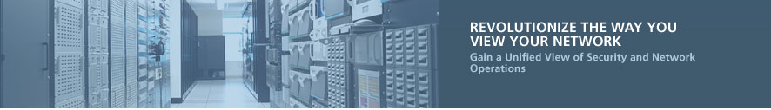
Router Tools: Lancope StealthWatch
Watch abnormal traffic patterns
Monitor bandwidth spikes
Routers should encrypt data & authenticate one another for traffic exchange
Test the Routers Built-in Filters that set limits on which IP’s can be used on other ISP networks

Slide 15

Network Scanning Tools
NAI’s Cybercop 5.5:
  Network Discovery: Ping scans, OS identification, TCP and UDP port scan, password guessing, SNMP data capture, limited app banner grabbing, limited packet sniffing, limited remote control software, no modem testing
  For UNIX: tests Trusted Host, TFTP, FTP/Anonymous FTP, Finger, NFS, NIS, Xwindows, Sendmail
  For Windows: Anonymous Null access (IPC$), unprotoected Registry Elements, Windows SMB File shares, Limited NT Service Pack level detection, no Netware or Vax vulnerabilities
  Web Security: Http server vulnerabilities, web browser vulnerabilities, firewall/router, router product, limited firewall product, DOS warnings and vulnerabilities
  Product Admistration Analysis and Fix Guidance, Scripting to add new scans,selectable tests, no scheduled scanning like CISCO secure scanner,customizable reports, product update, unlimited IP address ranges (ISS has a limit and CISCO is limited by # of hosts)

Slide 16
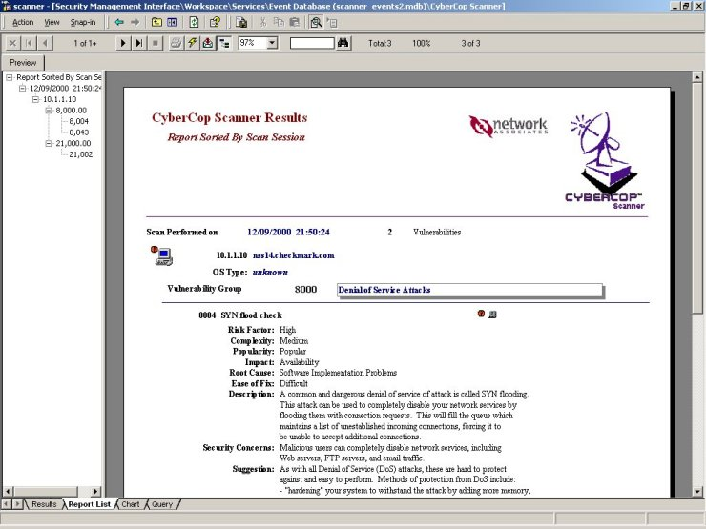
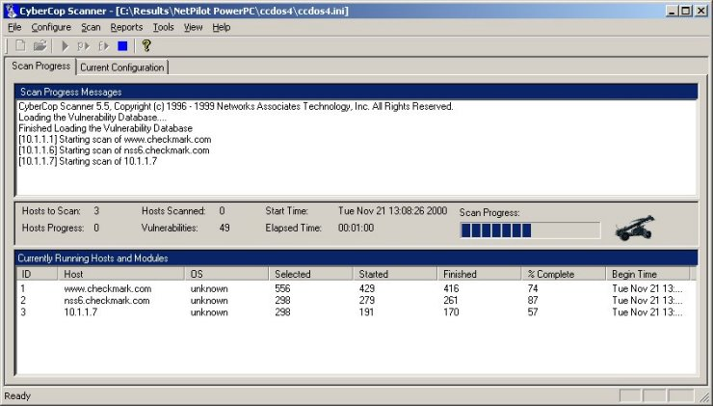
Example - CyberCop Scanner

Slide 17
DMZ
Small network/host between private and outside public network
Separated by another packet filter
Does not initiate any inward connections- no access to hosts within private network
Open subnet -> router -> proxy -> router -> internal network (good for web-commerce with SSL)
Testing should be done outside the network perimeter as well as inside
Notes:
Most common firewall environment – network connecting 2 firewalls

Slide 18
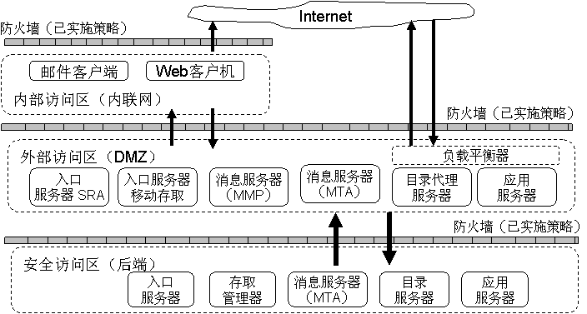
DMZ- a example

Slide 19

VPN
Remote users dial into local Point of Presence to connect
Provides private encrypted tunnel through public internet space - app
IPSec, PPTP, L2TP
Notes:
Your firewall encrypts the data then forwards it to remote VPN gateways. Decrypts it and passes it on.
Your intranet has no external connectivity while your Extranet is more like a B2B intranet using a VPN.

Slide 20
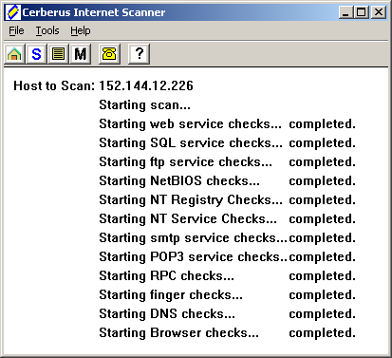
Cerebus Internet Scanner
(NT/2000-free tool Test points of failure, screen architecture, backdoors, holes
Modem scan in commercial version
http://www.cerberus-infosec.co.uk/cis/updates.html

Slide 21
www.whois.net
Social Engineering: phone numbers/contacts
DMZ Network Address targets
Backdoors
Even internal network address disclosures
DNS Server targets
Notes:
Ebay just recently had a redirect scam using FormMail. An email was sent to you to tell you your order was cancelled and to validate it at a redirected URL.

Slide 22
WEB Vulnerabilities
HTML: run as nobody - fork from root (binds to 80)
JAVA: signed applets
Jscript/VBScript: not in a sandbox
Active X: signed script policy
CGI, ASP, PHP, SSI
Notes:
Ebay just recently had a redirect scam using FormMail. An email was sent to you to tell you your order was cancelled and to validate it at a redirected URL.

Slide 23

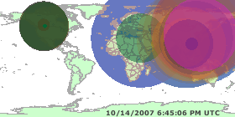
Host/Network Identification
Ipconfig /all
Nslookup
Nbtstat
Net use
Netstat -s 5 (intervals stats every 5 seconds)
http://visualroute.visualware.com/
http://www.hackerwatch.org/probe/
  oracle.com Unbreakable?
LANGUARD: DNS Lookup, Enumerate, Traceroute, New Scan

Slide 24
Viruses and Worms
Worms: self-propagating
  Transport mechanism for other apps
Viruses: infect another program by replicating itself onto the host
www.wildlist.org: Testing Anti-Virus
Hoaxes: www.kumite.com/myths or www.av.ibm.com

Slide 25
Password Cracking
Dictionary & Brute Force attacks
Don’t leave passwords in memory - empty arrays may be visible in core dumps
Disable emulators (telnet) that could show passwords in clear text: sqlplus
Limit the lifetime
Notes:
Brute Force uses Guessing Algorithms. Dicationary uses any type of dictionary (pop culture for example to crack).
LC3 by @Stake uses password auditing and is automated
How long it can take to crack: L0phtCrack can try over 450,000 guesses per second (NT).
A 4 digit numeric (pin for example) can be cracked in .02 seconds.
Use mixed case, alphas, special characters with variable length – can take 430 years

Slide 26
Valid Remote Apps vs Rogue
Carbon Copy, iCloseup, CoSession, ControlIT, Laplink, PCAnywhere, Reachout, Timbuktu, VNC
VS.
Back Orifice, Girlfriend, NetBus, PhaseZero, Sockets de Troi, Stacheldracht, SubSever, Trin00 DDoS Agent
PORT OF CALL…….next ->

Slide 27
Port List
7 Echo 66 SQL*NET
19 chargen 67,68 DHCP/bootstrap protocol server
20 FTP data 69 Trivial file transfer
21 FTP Control 70 Gopher
22 SSHD secure shell 79 fingerd
23 Telnet
25 SMTP service listens on
37 TIME (tcp/udp)
45,46,47 Page II
53 DNS Zone Transfers (tcp/udp)
Notes:
Note if the port is using TCP or UDP
UDP – user datagram uses connectionless state for lookups - faster
TCP – transmission control – domain name server for zone transfers- connections

Slide 28
Port List
80 httpd Web servers
98 LinuxConf
109-110 POP2/POP3
111/2049 RPC tcp/udp portmap & rpcbind
119 NNTP for newsgroups
123 NTP
135-138 NBT/NetBIOS in NT tcp/udp
139 NetBIOS Session Service tcp
143/220 IMAP
161-162 SNMP 161/UDP

Slide 29
Port List
179 BGP (tcp)
194/529 IRC
389 LDAP
443 SSL
512-513/TCP Berkley r commands: login,rexec,rsh
514/UPD Syslog
515 Unix: LDP (local print daemon) - can have a buffer overflow - turn off/etc/inetd.conf
543 MIT Kerberos
901 SWAT - Samba admin

Slide 30
Port List
ports above 1024 do not have to run as root for DNS:
  1080/tcp SOCKS
  1352 Notes Remote Protocol NRPC
  1521 /etc/services: {oracle listener-name}
    1 NFS
  2301 Compaq Insight Manager
  4045 lockd
  5190 AIM
  6000-6255 X Windows
  7777 Apache web server
  8000-8080 HTTP
  8888 Netscape default Admin Server
  32770-32789 RCP Loopback ports - Unix; remote procedure call vulnerable for buffer overflows
  63148 IIOP

Slide 31
More Tools….
AW Security Port Scanner
Network File Shares
Software Banner Grabbing: telnet qasecure.com
www.netcraft.com
Trace Routes/Hops
Packet Sniffers
Check out www.stickyminds.com for templates, articles, and test tools

Slide 32
Other Technologies
Biometrics
Wireless/802.11b
Smart Cards
Tokens
Global Positioning

Slide 33
Policy
Your company’s security team (NOT the software testing team alone) determines policy on user access, time outs, content availability, database viewing, system protection, security tools etc. As a team we need to document and model our structures, flows, dependencies, and protocols
The role of the test group is test the existing system to look for errors in security implementation, primarily at the application level. Gather configuration issues for the tech support knowledge base
IT is generally responsible for network security, firewall testing, packet counting, traffic monitoring, virus protection, and server-break in testing. They would install IP address screening policies
Tying it together with cross-team buy-in
Notes:
Bridging the testing Principles together: security is not ad hoc/plug and play. After the fact patching is better than not at all but much more difficult than test being involved in the design of the system. Policy should take into account liability.
Make sure you do a risk analysis: determine the IMPACT vs. the COUNTERMEASURES you already have in place.

